Slide 1
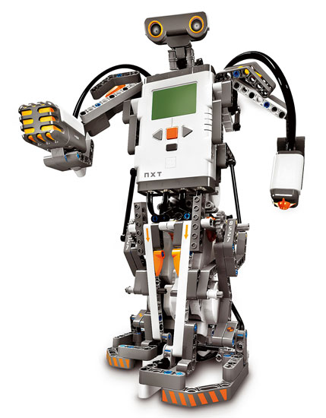
Cognitive Approach to Robot Spatial Mapping
Ghislain Fouodji Tasse
Supervisor: Dr. Karen Bradshaw
Computer Science Department
Rhodes University
04 August 2009

Slide 2
concepts
Robot Spatial Perception: it is the way the robot perceives it environment and interacts with it.
Cognitive mapping: different AI approaches that can be implemented to built self mapping intelligence into a robot.
Cognitive Robot Mapping: cognitive mapping theories are interpreted and converted into algorithms that can be implemented in robot, with respect to its perception of the environment.

Slide 3
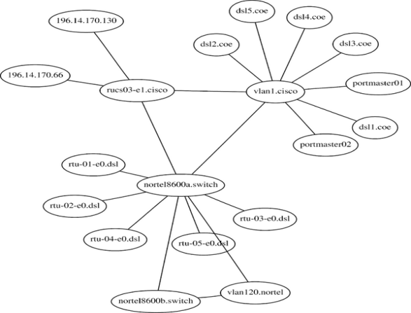
Robot Spatial Perception
Metric map: is the capture of the geometric properties of an environment.
Topological map: is the capture of qualitative and relational information of the objects in an environment.

Slide 4
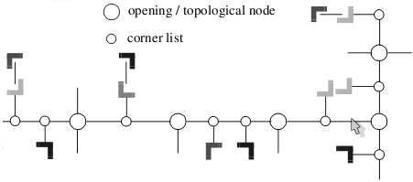
Robot Spatial Perception
Hybrid map: it contains both metric and topological information of the environment.

Slide 5
Possible diffficulties
Odometry Errors: these errors result from the limitation of robot sensors.
SLAM: Simultaneous Localization and Mapping problem.
Dynamic Environments: How does the robot cope with the change in the environment.

Slide 6
Cognitive mapping
Vision Based Mapping: this mapping focuses on the visual information the robot gets from the environment.
Shaped Based Mapping: this mapping focuses on the geometric information the robot gets from the environment.

Slide 7
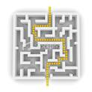
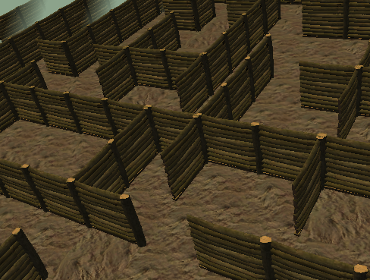
Cognitive Robot Mapping
LSR: Local Space Representation is the representation of the space the robot is currently experiencing.

Slide 8
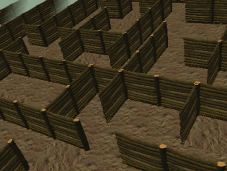
Cognitive Robot Mapping
GSR: Global Space Representation is the combination of independent local space representation.

Slide 9
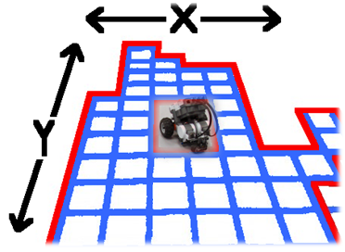
Cognitive Robot Mapping
Grid Algorithms: treats the environment as an unstructured array with composed cells that are independently either occupied or unoccupied.

Slide 10
Tools
Robot: Lego Mindstroms NXT (2 motors and 4 ultrasonic sensors)
Bluetooth Connection
Programming Languages: C/C++
IDE: Visual C++

Slide 11
Extentions
This research is a first step and can be extended to achieve complete and optimal self navigation with free collision in the real world by a robot.
The concept of cognition could be extended to other area in robotics such as natural language processing.
This project can be extended from an indoor environment mapping to an outdoor environment mapping.

Slide 12
?

